Slide 1


UNIVERSITY OF BASRA
COLLEGE OF MEDICINE
DEPARTMENT OF PATHOLOGY AND FORENSIC Medicine
Introduction to
Haematopathology
Dr. Ala’a A.Razak Abood
Iraqi Board of Haematopathology

Slide 2
Definition :
Haematopathology is the branch of pathology concerned with the study of the diseases and disorders related to blood cells, their production and blood forming organs.

Slide 3
Objectives
Define haemopoiesis and the related processes to it.
list normal blood constituents.
Define, classify anemia and its clinical features.
Define and classify polycythemia.

Slide 4
Haemopoiesis:
Definition : the process of blood formation
Erythropoiesis
Myelopoiesis
Thrombopoiesis
The process of haemopoiesis starts from a pluripotent stem cell that characterize by its ability for self – renew and give rise to the separate cell lineages.

Slide 5
CFU, colony - forming unit; E, erythroid; Eo, eosinophil; GEMM, granulocyte, erythroid, monocyte and megakaryocyte; GM, granulocyte, monocyte; Meg, megakaryocyte; NK, natural killer.
Bone marrow pluripotent stem cell and the cell lines that arise from it.

Slide 6
Blood cells :

Slide 7
Red Blood Cells
Erythropoiesis, Anemia
and Polycythemia

Slide 8
Erythropoiesis:
CFU GEMM
BFU E
CFU E
Pronormoblast

Slide 9
Pronormoblast

Slide 10
Erythropoietin:

Slide 11

HOW Plasma erythropoietin levels can be valuable in clinical diagnosis

Slide 12
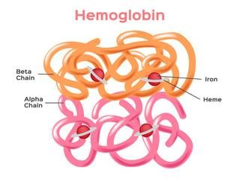
Haemoglobin:
Hb A = α₂β₂
(96-98 %)
Hb F = α₂γ₂
(0.5 – 0.8%)
Hb A₂ = α₂δ₂
(1.5- 3.2 %)

Slide 13
The Red blood cells disorders
Anemia
Polycythemia

Slide 14


Slide 15
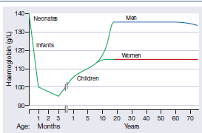
Anemia
This is defined as a reduction in the haemoglobin concentration of the blood below normal for age and sex.
13.5 g/dl
14 g/dl
11.5 g/dl
11 g/dl

Slide 16
Clinical features of anaemia
The presence or absence of clinical features can be considered under four major Headings:
1. Speed of onset.
2. Severity.
3. Age.
4. Haemoglobin O 2 dissociation curve .

Slide 17
Symptoms
shortness of breath
Weakness
Lethargy
Palpitation
headaches.
symptoms of cardiac failure, angina pectoris or intermittent claudication or confusion maybe present.
Visual disturbances because of retinal haemorrhages

Slide 18
Signs
General signs

Slide 19
Specific signs

Slide 20
    Classification of anaemia
According to the cause of anemia:
1- Blood loss: a- acute
b- chronic
2- Inadequate production of normal blood cells:
a- iron deficiency anemia.
b- megaloblastic anemia.
3- Excessive destruction of blood cells (hemolytic anemia)

Slide 21
According to the RBCs morphology
Normocytic normochromic.
Microcytic hypochromic.
Macrocytic.

Slide 22
    Laboratory findings in anaemia
Red cell indices :
Macrocytic | Normochromic Normocytic | Hypochromic Microcytic
MCV ≥ 95 fl | MCV 80-95 fl | MCV < 8o fl
 | MCH ≥ 27 pg | MCH < 27 pg
Megaloblastic: folate and vitamin B12 deficiency. Non megaloblastic : alcohol, liver disease. | After acute blood loss. Bone marrow failure | Ex. Iron deficiency anemia and thalassemia minor

Slide 23
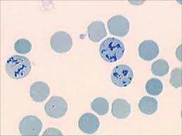
Leucocyte and Platelet count:
- Distinguish pure anemia from pancytopenia.
Reticulocytes count:
These are immature red blood cells with a normal percentage between 0.5–2.5% which should rise in anemia because of erythropoietin increase, and be higher the more severe the anemia.

Slide 24
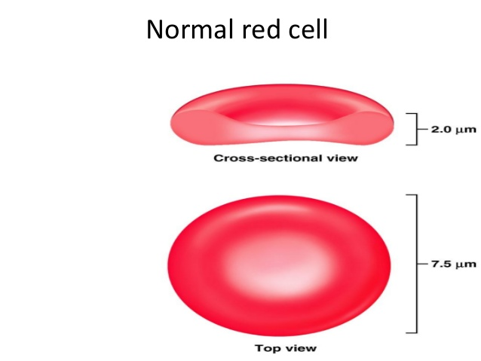
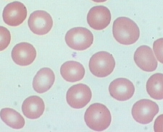
Blood film
It is essential to examine the blood film in all cases of anemia.
Pale stained center of RBC = 1/3

Slide 26
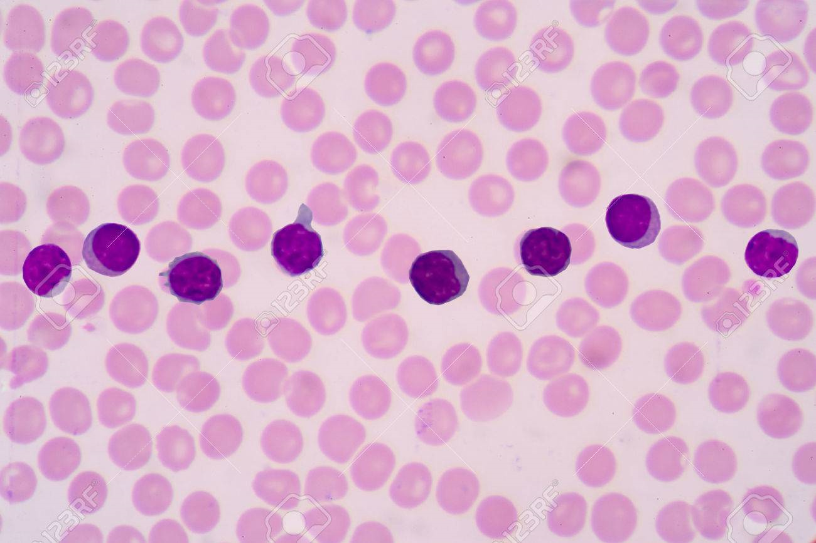
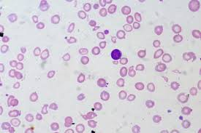
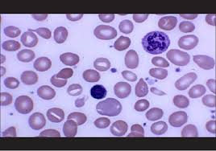

Slide 27
Bone marrow examination
- This is needed when the cause of anemia or other abnormality
of the blood cells cannot be diagnosed from the blood count,
film and other blood tests alone.
- It may be performed by aspiration or trephine biopsy

Slide 28


Slide 29
    Definition of Polycythemia:
Increase in the haemoglobin concentration above the upper limit of normal for the patient’s age and sex.

Slide 30
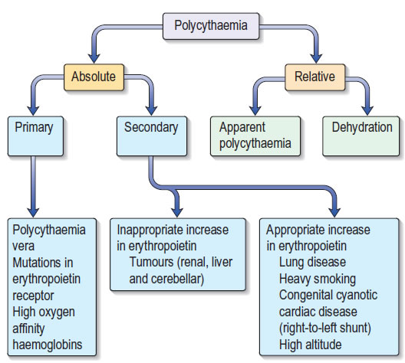
    Classification of Polycythemia:

Slide 31


